Slide 1
Online Chocolate Shop Management System
Presented by : Crazy Engineers

Slide 2
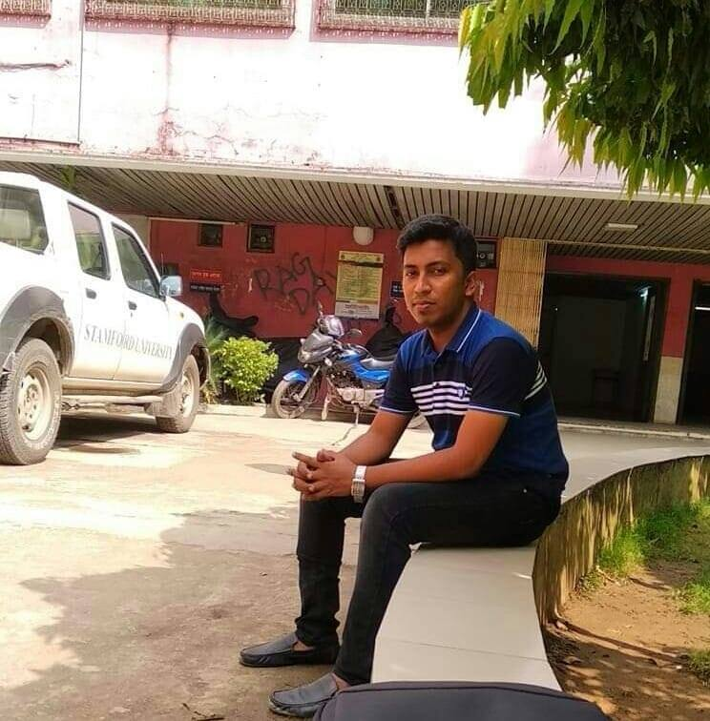



team
Md Nazim Uddin
Priyanka Rani Satu
Md. Naeemul Hasan
Janith Sultana JUTHI
CSE 063 07429
CSE 063 07380
CSE 063 07438
CSE 063 07477

Slide 3
Data Flow Diagram (DFD)

Slide 4
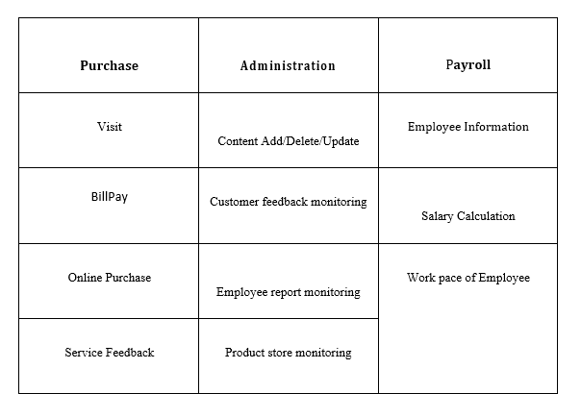
Activity Lists

Slide 5
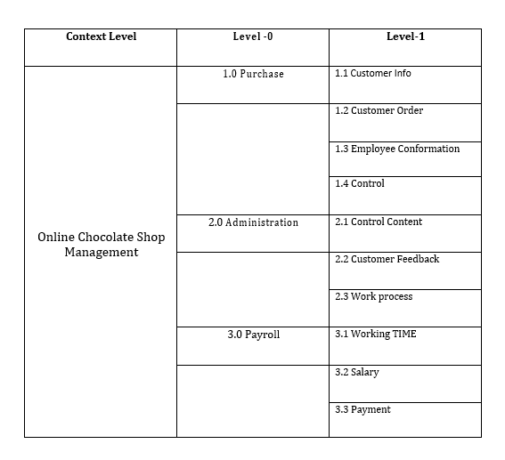
Decomposition of DFD

Slide 6
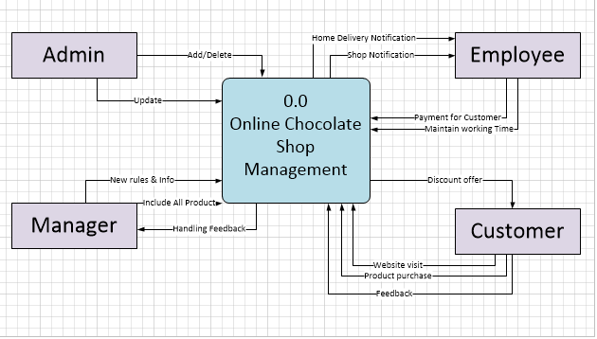
Context Level

Slide 7
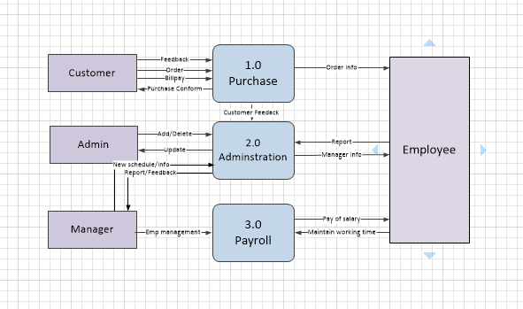
Level- 0

Slide 8
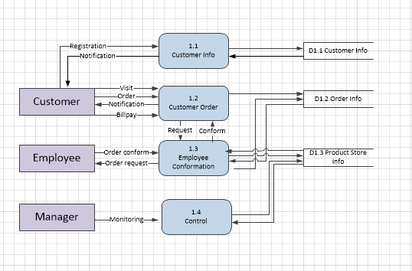
DFD Level 1

Slide 9
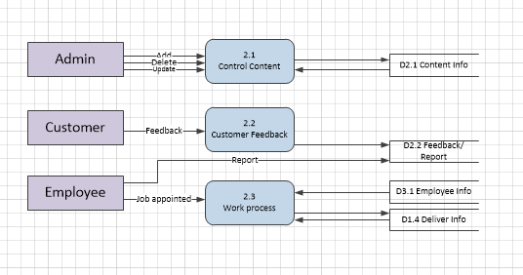
DFD Level 1

Slide 10
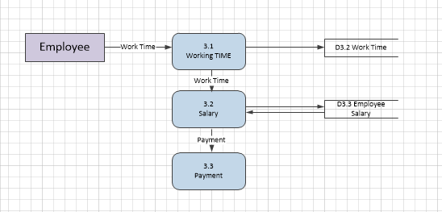
DFD Level 1

Slide 11



Slide 12
Thank you

